Slide 1

BSSE -Software Quality Engineering
Week-2 Lecture 3
Semester 6- Fall 2020

Slide 2
QA in context – QA as Defect Handling
Ms. Zarsha Nazim

Slide 3
Learning Outcomes
Lecture Overview
Course Introduction, Objectives and Contents
An Initial Definition of (Software) Quality
Standard Definitions of (Software) Quality
Quality Problems in Large Software
Turning Failure to Success: SQE
SQE for Meeting Quality Expectations
The SQE Process
Scope of Major SQE Activities

Slide 4
Quality Assurance Basics
Software products are not built overnight. It takes a lot of efforts, team coordination,
development and testing to come up with a final version of the product. Regardless of the
software product, its complexity or size, the purpose of QA remain same; to reduce the defects
to minimum to ensure minimum disruption. High priority or the sensitive areas of the product
should be defects free but as mentioned in the last module, it’s not possible to have a software
product with zero bugs. Through following standards and best practices the number of defects
can be reduced to a minimum level but cannot be totally removed from the product.

Slide 5
QA and Defect
QA and defects are always tied to each other and their relationship can never vanish. QA always try to keep defects at a minimum level and for this adopts different approaches to avoid damages to the software product because of defects.
The last resort is that the critical functionality of the software product should work at least and defects must not be producing any kind of threat or damage to the critical function of the product.

Slide 6
QA and Defect: Classification Scheme
Defects can be classified into three categories. These are as follows along with brief explanation of them.
● Defect Prevention - Error Source Removal: Defect Prevention is the process of addressing root causes of defects to prevent their future occurrence.
● Default Detection: it’s a process to detect and remove defects as early/many as possible through various approaches like QA, code reviews, code inspection and design review.
● Default Containment: it measures the amount of defects that any QA team was able to find as a portion of total defects i.e. found by QA, appeared as run-time error. The focus of this activity is to reduce/eliminating escaping defects.

Slide 7
Pre-Release Defects
Pre-release defects are defined as ‘Dormant Defects’ which have potential to create problem to users and customers.
These inactive defects are triggered on a specific situation or may occur in a low priority area where the concentration of QA activities is low and they might not get specific attention until they are triggered.

Slide 8
The following example would help in establishing a better understanding of the concept.
Imagine the following scenario:
‘The cash register scans thousands of items such as bread, milk and cheese every day without trouble. However, when someone buys products and use cash + credit card and gift voucher to pay for it? Since this is not common way of payment it was not tested properly and it had a bug, now whole system Is in wait state due to this?
Pre-release defects if generated at client sites then depending on impact it has to be fixed but they are usually part of release notes.

Slide 9
Post-Release Defects
Post-release defects are those who appear in production or at customer site. The software supplier company has to pay for its pocket to fix those post-release defects.
Post-release defects have higher cost of fixing as compared to other defects because of multiple installation of the product and the defect has to be fixed at every place. Besides financial loss, company image, trust

Slide 10
Example of Post-Release Defects
Consider the following scenario:
‘There was functional requirement to export logs generated from database into CSV file so user can analyze it later on. During testing CSV was tested and working fine but at Production site CSV was generated but records went missing in the files and it require hot-fix at production
site.
After careful analysis it was revealed that after 500000 records in CSV more records went
missing when writing it from Database and it was decided to generate separate CSV after
500000 records and in the end merge two files to generate third CSV. During QA CSV was tested
for 30000 records because there was no upper limit mention in SRS.’
Production level bugs have very high cost plus it can hit reputation also.

Slide 11
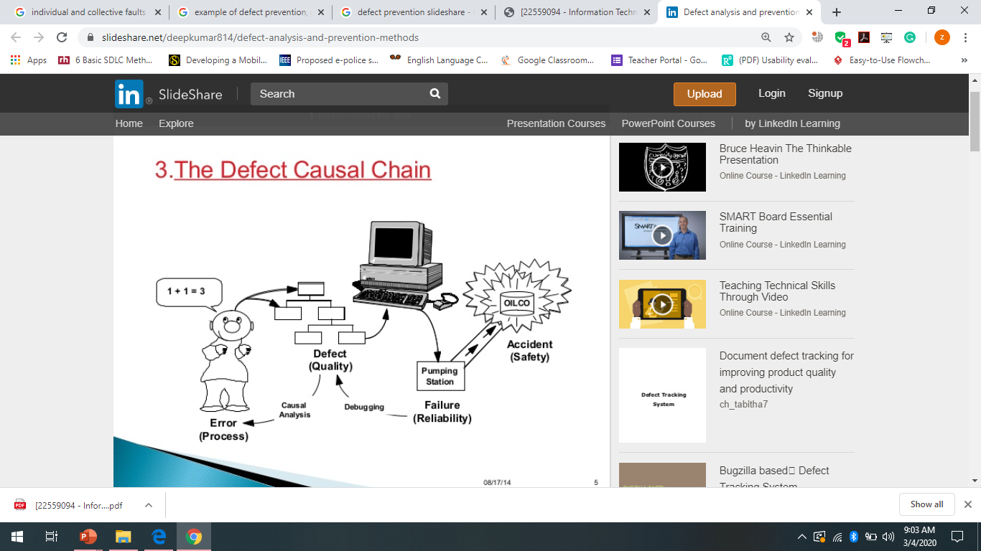
How to detect defects early

Slide 12
■ Inspections and reviews
■ Prototyping, extensive customer interaction
■ Note that agile development emphasizes these
■ Use of analysis techniques:
■ Requirements analysis for completeness and consistency
■ Design analysis, such as sequence diagrams to analyze functional correctness, quality attribute analysis
■ Formal specification and analysis of requirements
■ Methodologies that increase early lifecycle effort & depth:
■ Test-driven development increases understanding of relationships between design and requirements  Traceability analysis
■ Incremental development to expose defects in early operation

Slide 13
